Slide 1
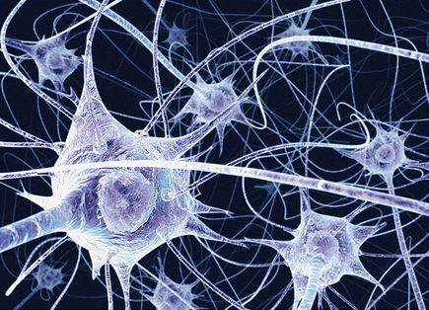
Coordination and response
Nervous control in humans
IGCSE Biology

Slide 2
Learning objectives
By the end of this topic, you should be able to:
Define sense organs, synapse and sensitivity
State the composition of human nervous system
know CNS and PNS
Describe how a neurone adapt to its function
know the position of cell bodies of neurones in a reflex arc
explain how reflex actions occur in terms of reflex arc
appreciate the value of reflexes
describe how a synapse work

Slide 3
Question list I – human nervous system
By what two means do animals coordinate and respond to stimuli?
What is a CNS (central nervous system) and a PNS made of (in mammals)?
a) What kind of stimuli can we detect?
b) What specialised cells in sense organs enables us to detect different stimuli?
a) What is a typical neurone like? List the structures you can find on a neurone.
b) How is a typical neurone specialised/ adapted to perform its function?
5. a) Give two examples of reflex actions.
b) What the point of having reflex actions of our body?
c) Give two examples of voluntary actions.
d) Compare differences of a voluntary action and involuntary action.
e) How does a reflex action occur? What is the structure underlying a reflex action?

Slide 4
Question list I – human nervous system
6. a) What term do we use to call the information that is passed on by neurones?
b) What structure ensures nerve impulses move on one-way direction?
c) How does it work?
d) What organelle exists in great numbers in neurones? Explain.
7. Use Fig. 13.4 on page 163, state where are the cell bodies of a sensory neurone, a relay neurone and a motor neurone in a reflex action?

Slide 5
Coordination
All living organisms have 7 common characteristics. Which characteristic is related to “sense and respond”?
Sensitivity.
Coordination: the ability to use different parts of the body together smoothly and efficiently.
Animals usually coordinate responses via two ways: nervous system and endocrine system (hormones).

Slide 6

The nervous system
The nervous system or the neural system is a complex network of neurons specialized to carry messages. The complexity of the nervous system increases as we move towards higher animals.
For instance, cnidarians such as jellyfish have relatively simple nerve nets spread throughout their body. Crabs have a more complicated nervous system in the form of 2 nerve centers called dorsal ganglion and ventral ganglion.
As we move further up the ladder, higher organisms such as vertebrates have developed the brain. Moreover, it is one of the most complicated structures in the animal kingdom, containing billions of neurons, all intricately connected.
Notes:
cnidarians (hydroids, jellyfish, sea anemones, corals)
Cnidaria is a phylum under kingdom Animalia containing over 11,000 species of aquatic animals found both in freshwater and marine environments, predominantly the latter. An aquatic invertebrate animal of the phylum Cnidaria.

Slide 7
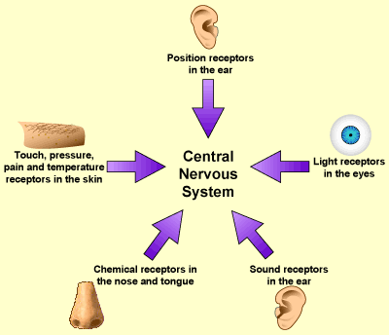
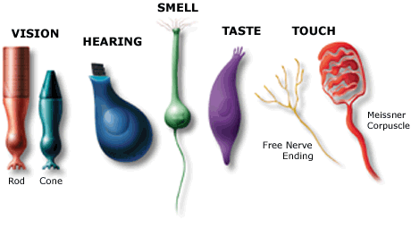
Sense organs
The definition:
groups of receptor cells responding to specific stimuli (light, sound, touch, temperature and chemicals)
The sense organ we will study in detail is the eye.
Sense organs are specialized organs that help to perceive the world around us.
Q: What kind of stimulus can each sense organ detect?

Slide 8
Fun facts
The senses of smell and taste tend to work together. If one could not smell something, they could not taste it either.
Special receptors includes chemoreceptors, photoreceptors, and mechanoreceptors.
Taste buds on the tongue contain chemoreceptors that work similarly to the chemoreceptors in the nasal cavity.
During a cold, the body produces mucus which blocks the sense of smell, this is the reason why the food which we eat tastes bland.
But besides these five sense organs, there are another two that help to orient us with the world. They are: Vestibular system and Proprioception system.
https://byjus.com/biology/sense-organs/
Notes:
Vestibular: of, relating to, or affecting the perception of body position and movement.
proprioception: the reception of stimuli produced within the organism.

Slide 9
Fun facts
Vestibular system
The vestibular system acts as a sensory system of the body in the inner ear and is responsible for transmitting the information to our brain about the motions, head position, and spatial orientation. This system is also involved with motor functions and helps in
Maintain our body posture.
Maintaining our body balance.
Stabilize our head and body during movement.
Identifying the orientation and posture of our bodies in relation to the environment.
Thus, the vestibular system is essential for normal movement and equilibrium.
Proprioception system
Proprioception (the ability to sense the position and location and orientation and movement of the body and its parts) system is described as the conscious or unconscious awareness of joint position. This system helps the body to identify the muscles, joints and limbs is located in 3D space and the direction it is moving in relation to the body.
Walking or kicking without looking at our feet, balancing on one leg, touching the nose with eyes closed and the ability to sense the surface on which we are standing upon, are a few examples of proprioception system.

Slide 10
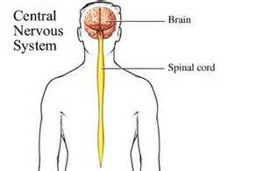
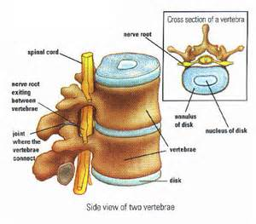
The central nervous system
It is a site where the received information is processed and integrated for the action or response by effectors.
The brain is protected by the skull.
The spinal cord is protected by the vertebral column (backbone).
CNS and PNS in human and other vertebrates.
Notes:
Integration: Integration involves sorting and interpreting incoming sensory information and determining the appropriate response

Slide 11
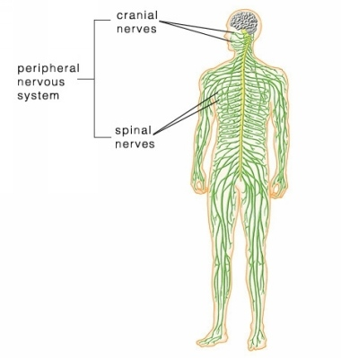
The peripheral nervous system
All the nerves associated with the CNS.
The PNS consists of all the:
sensory neurones: transmits nerve impulse from organs or tissues to CNS
motor neurones: transmits impulses from the CNS to peripheral organs or tissues
https://byjus.com/neet/process-of-neural-communication/

Slide 12
The peripheral nervous system
The PNS is divided into two types based on the organs/tissue it transmits the nerve impulse to. These are:
Somatic nervous system: Impulse is transmitted from CNS to skeletal muscles
Autonomic nervous system: Impulse is transmitted from CNS to smooth muscles and involuntary organs of the body

Slide 13
Actions
involuntary
voluntary
- not under conscious control, including reflex actions (also called reflex).
E.g. Breathing, heartbeat, sneezing, vomiting, digestion, etc.
- involve conscious control by the brain.
Both spinal cord and brain are involved
E.g. Walking, eating, doing exercise, etc.
Reflex action or reflex is an involuntary action in response to a stimulus.
This is a spontaneous action without thinking.
From an evolutionary perspective, reflex action has played an important part in ensuring the survival of organisms as it has enabled quick reactions to certain situations where an organism’s life could be at stake.

Slide 14
Reflex (actions)
There are many other examples of reflex actions.
Examples of reflex actions include:
pulling your hand away from a hot object
blinking when dust gets in your eye
pupil reduces in diameter in bright light.
Knee-jerk reaction
Reflexes are:
automatic – you don’t have to think about them.
fast – and
protective – to prevent your body from being damaged.
Reflexes are processed in the spinal cord, not in the brain.
Notes:
unconditioned reflex, conditioned reflex

Slide 15
Reflex arc
The pathway in which impulses travel during the reflex action is called a reflex arc, which include:
Receptor (specialised cell in sense organs),
sensory neurone,
relay neurone,
motor neurone,
effector.

Slide 16
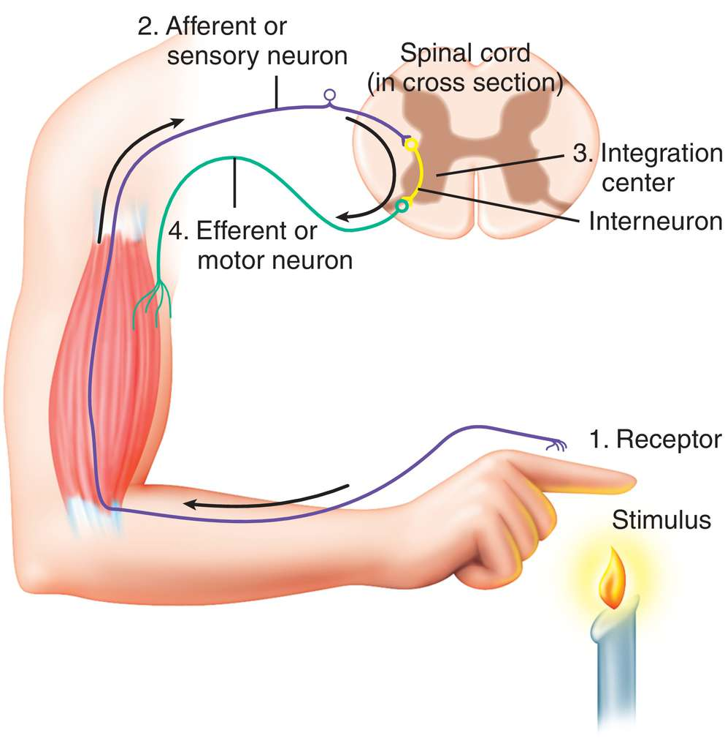
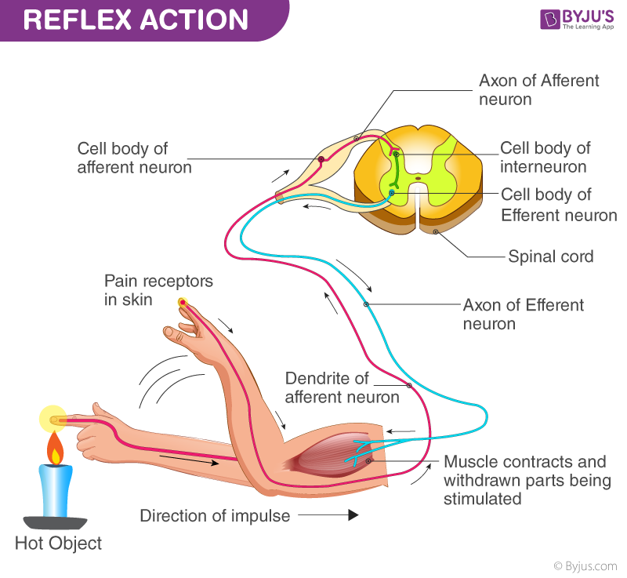
effector
The neuron is a highly specialized cell that transmits an electrical signal called nerve impulses or action potential.

Slide 17
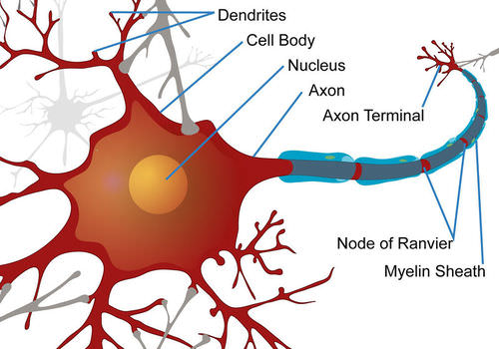
Neurone
A neuron has three main parts:
The cell body/ soma.
Many dendrites.
One axon.
https://www.khanacademy.org/science/biology/human-biology/neuron-nervous-system/v/anatomy-of-a-neuron
https://www.ck12.org/biology/nerve-impulse/lesson/Nerve-Cells-and-Nerve-Impulses-MS-LS/
Notes:
Each neuron has as many as 15,000 connections with neighboring neurons.

Slide 18
https://mammothmemory.net/biology/coordination-and-response/nerves/three-types-of-neurone.html

Slide 19
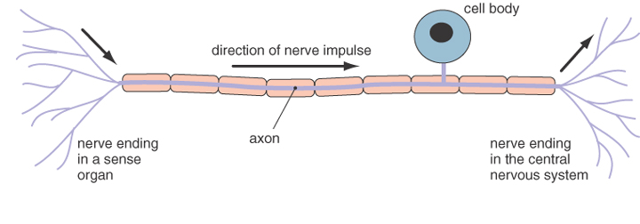
Sensory neurones
https://qbi.uq.edu.au/brain/brain-anatomy/types-neurons
These transmit nerve impulses from receptor cells (in sense organs) to the brain and spinal cord (CNS).

Slide 20
A nerve cell
Cell body: cytoplasm with a nucleus, cell organelles, Nissl’s granules. The cell body integrates incoming signals
Dendrite: short, highly branched fibres that project outwards from the cell body. They are specialised to receive stimuli and signals to the cell body
Axon: single long fibre, branched at the terminals. Axon conducts nerve impulses away from the cell body to another neuron, muscle or gland.
Myelin sheath: Axon of many neurons are surrounded by a series of cells called Schwann cells. The plasma membrane of these cells contains myelin, a white fatty material. Schwann cells wrap their plasma membrane around the axon, forming an insulated covering called the myelin sheath. Gaps in the myelin sheath are known as nodes of Ranvier.
There are two types of axons:
Myelinated: It is found in spinal or cranial nerves
Non-myelinated: It is found in autonomous and somatic nervous systems

Slide 21
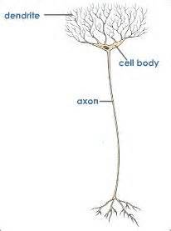
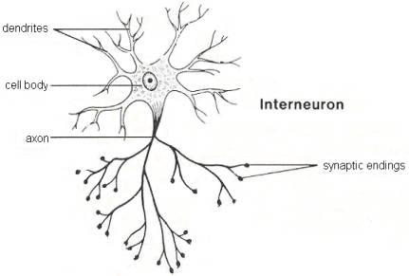
Relay neurones
Relay neurones are short cells that pass on impulses from sensory neurones to motor neurones inside the brain and spinal cord.
Notes:
Found only in CNS.

Slide 22
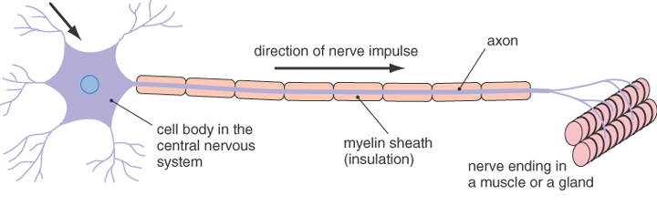
Motor neurones
These transmit impulses away from the brain and spinal cord to effectors, which can be muscles or glands.

Slide 23
How do impulses pass across neurones?
The diagram below summarizes neural transmission within the nervous system.
These impulses travel from one neuron to another by crossing a synapse. The messages are converted from electrical to chemical and then back to electrical.
Each neurotransmitter has its own specific family of receptors.

Slide 24
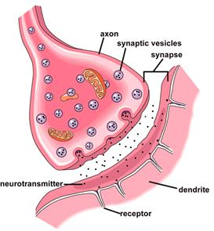
Synapses
A junction (not gap) between two nerve cells, between the terminal branches of axon of one neuron with the dendrite of another neuron.
which include:
Presynaptic membrane
The gap between neurones
Postsynaptic membrane
Synapse can be between two neurons or between a neuron and effector such as neuron and a muscle cell.

Slide 25
Synapses
Chemicals (neurotransmitters) are released at the end of axon and this is caused by the electrical impulse.
These chemicals diffuse cross the gap.
The chemo-receptors (this is receptor molecules on the cell membrane of dendrites) present in the dendron gets stimulated and similar electrical impulses are created in the dendrite of the next neuron. Thus the generation of signal continues.
Notes:
Neurotransmitters are chemical messengers that transmit a signal from a neuron across the synapse to a target cell, which may be another neuron, a muscle cell, or a gland cell.
The exact number of unique neurotransmitters in humans is unknown, but more than 500 have been identified.
Binding of neurotransmitters may influence the postsynaptic neuron in either an excitation or inhibitory way, depolarizing or repolarizing it respectively.
After a neurotransmitter molecule has been recognized by a post-synaptic receptor, it is released back into the synaptic cleft. Once in the synapse, it must be quickly removed or chemically inactivated in order to prevent constant stimulation of the post-synaptic cell and an excessive firing of action potentials.

Slide 26
Main definitions
Stimulus | A change that can be detected. E.g. sound, light or temperature.
Receptor | A cell or organ that receives a stimulus and converts it into an electrical impulse.
Sensory neurone | Carries the nerve impulses from the receptor to the central nervous system.
Relay neurone | Carries the impulse across the spinal cord.
Motor neurone | Carries the impulse from the CNS to the effector.
Synapse | A junction between two neurones.
Effector | A muscle or gland that carries out an action (response) to deal with the original stimulus.

Slide 27
Quiz
1 ensure that nerve impulses travel in one direction.
2 The binding of and triggers a nerve impulse in next neurone.

